Slide 1

S.MAHADEVAN
RA1511003010422
CSE DEPARTMENT
PYTHON PROJECT– MACHINE LEARNING
S.Mahadevan
RA1511003010422
CSE Department

Slide 2
INTRODUCTION
The formal definition of machine learning, given by Tom M.Mitchell is "A computer program is said to learn from experience E with respect to some class of tasks T and performance measure P if its performance at tasks in T, as measured by P, improves with experience E.”
Practically, this means that we can feed data into an algorithm, and use it to make predictions about what might happen in the future. This has a vast range of applications, from self-driving cars to stock price prediction.
In this project, we are going to explore a board game dataset, acquired from BoardGameGeek and figure out interesting things to predict.
The libraries used in this project are Pandas, Scikit-Learn and matplotlib.

Slide 3
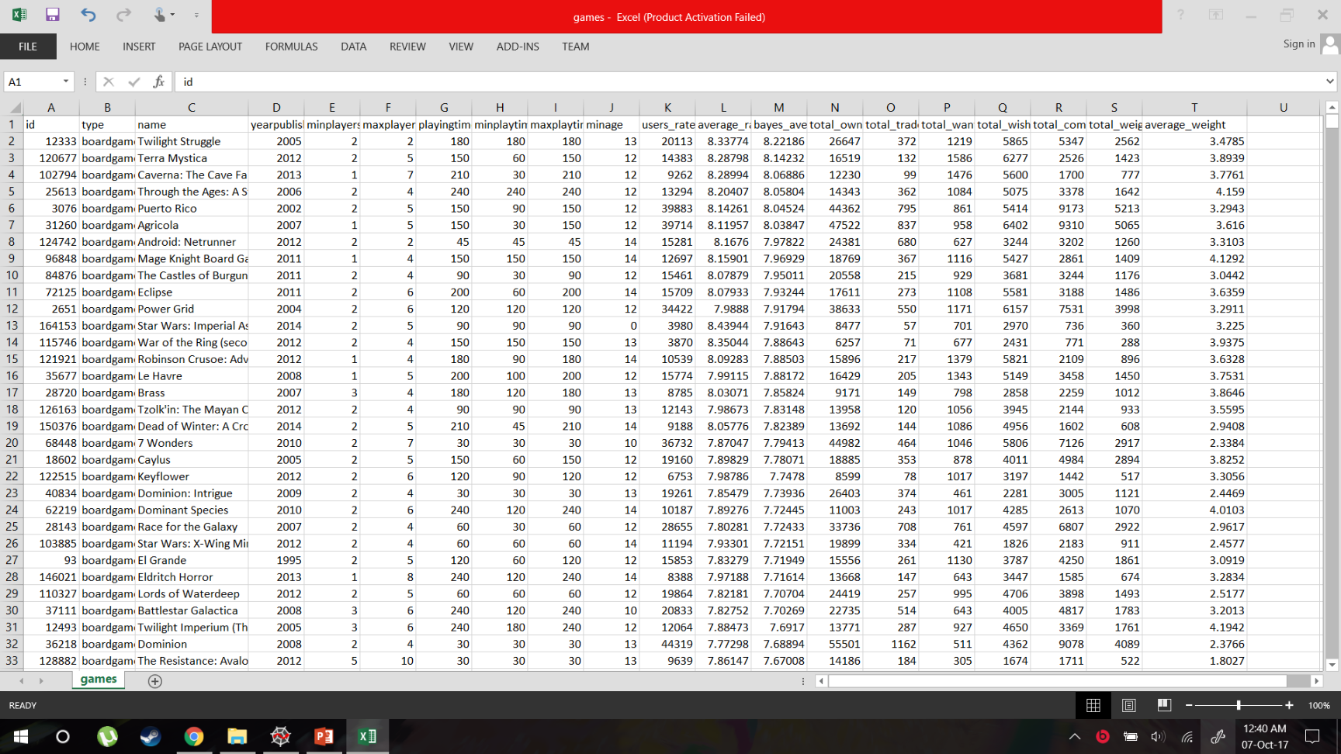

Slide 4
ABSTRACT – FOCUS TESTING
This project is about finding patterns in a board game database. The database contains 81312 rows and 20 column attributes
We are going to use an algorithm like K-Means to cluster the given data in different clusters based on the average user rating given by the user.
Additionally, we are going to predict the average rating a user would give to a new unreleased board game based on its attributes, using linear regression.
For checking the error between the training and the test sets, we are going to use the mean squared error metric.

Slide 5
MODULES
Pandas – This library will be used to import the database, given in .csv format, into Pandas dataframe. Additionally, it is also used for performing other dataframe operations.
Matplotlib – This library would be mainly used for the plotting of graphs, histograms of the given data.
Scikit-Learn – Scikit-learn is a machine learning library for the Python programming language. It features various classification, regression and clustering algorithms including support vector machines, random forests, gradient boosting, k-means and DBSCAN, and is designed to interoperate with the Python numerical and scientific libraries NumPy and SciPy.
Anaconda - Anaconda is a freemium open source distribution of the Python and R programming languages for large-scale data processing, predictive analytics, and scientific computing. It comes pre installed with the Pandas, Matplotlib and Scikit-Learn packages.

Slide 6


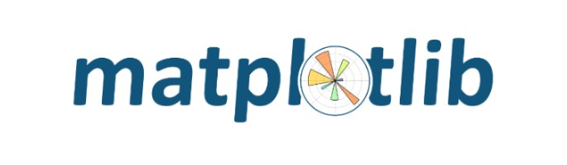


Slide 7
IMPLEMENTATION
We are going to import the database, in the .csv format into the python environment.
import pandas
games = pandas.read_csv("games.csv")
print(games.columns)
By plotting a histogram of the given database on any one field, like average rating, can give us a fair idea about the data distribution.
import matplotlib.pyplot as plt
plt.hist(games["average_rating"])

Slide 8
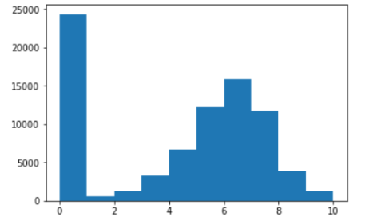
Making observations on the histogram, we can infer that that separate clusters can be formed on the basis of the average rating. We use K-Means to plot those clusters.
from sklearn.cluster import KMeans
kmeans_model = KMeans(n_clusters=5, random_state=1)
good_columns = games._get_numeric_data()
kmeans_model.fit(good_columns)
labels = kmeans_model.labels_

Slide 9
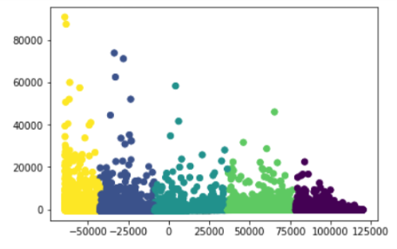
from sklearn.decomposition import PCA
pca_2 = PCA(2)
plot_columns = pca_2.fit_transform(good_columns)
plt.scatter(x=plot_columns[:,0], y=plot_columns[:,1], c=labels)
plt.show()
We can find out the correlation of the different fields with average rating to see which field has the most weightage on the prediction of the average rating using the following command.

Slide 10
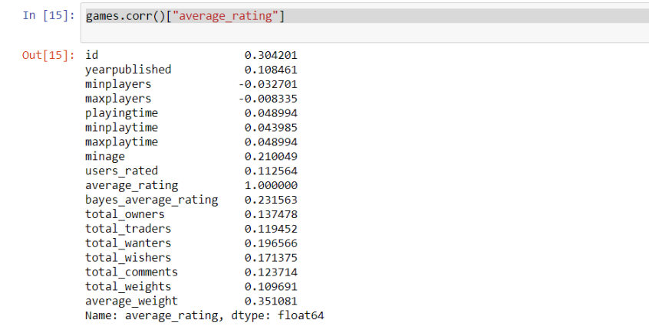
games.corr()["average_rating"]
Based on the above given table we can see that the fields which have carry the most weightage to predict the average rating, are average_weight and id.
ids are presumably assigned when the game is added to the database, so this likely indicates that games created later score higher in the ratings. Maybe reviewers were not as nice in the early days of BoardGameGeek, or older games were of lower quality. average_weight indicates the “depth” or complexity of a game, so it may be that more complex games are reviewed better.

Slide 11
CONCLUSION
As one can see, this project can be extrapolated to other media, which work on a user rating basis.
It can be used to focus test various products and services, before the company makes a mistake and spends a significant amount of money on a failed product.
For example, if Amazon is releasing a niche product like the Fire phone into the market, instead of wasting a ton of marketing money, it could use this kind of a focus testing application to check whether they are reaching the desired market.
At the moment, the project is at it’s most nascent of stages, and can only predict the rating, based on two features. Later as the project improves, It can predict the average rating based on a number of features, to give a better rating.

